Slide 1



Rafting for Everyone

Slide 2
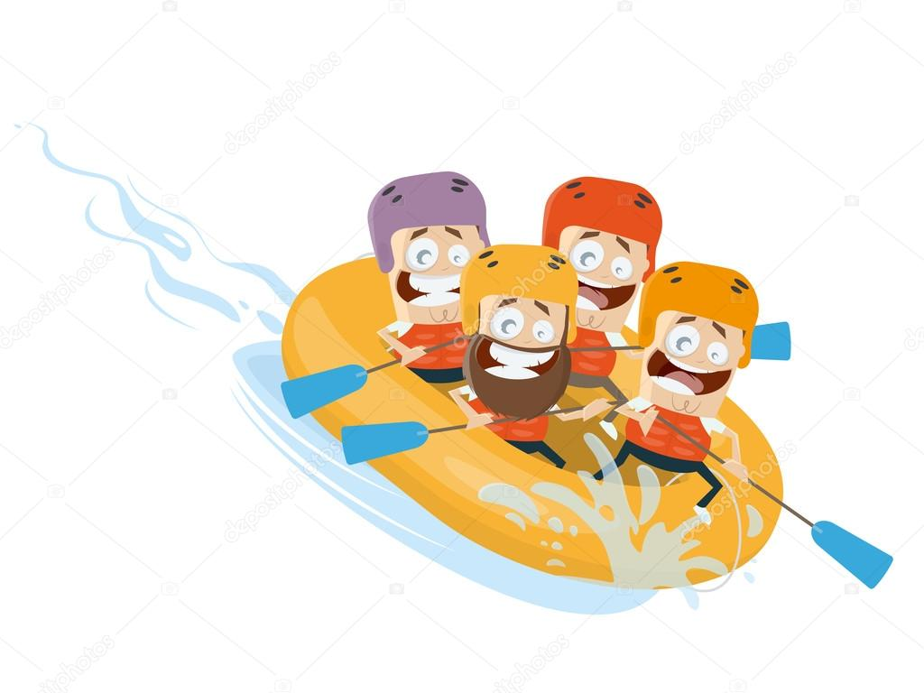




Slide 3


Rafting for Everyone

